Slide 1
THINK | BIG Behavioral Integration Guidance
Accelerator Behavior Profiles
Notes:
TITLE: Gills Sans MT, Size 24, White
DATE: Gills Sans MT, Size 16, White
*Note: Per branding regulations Gill Sans must be used for all USAID documents.
SIZE: Make sure the size of the PPT is set to high definition (16:9)
To do this, go to: Design → Page Setup

Slide 2
Accelerator Behavior: Care for Pneumonia

Slide 3
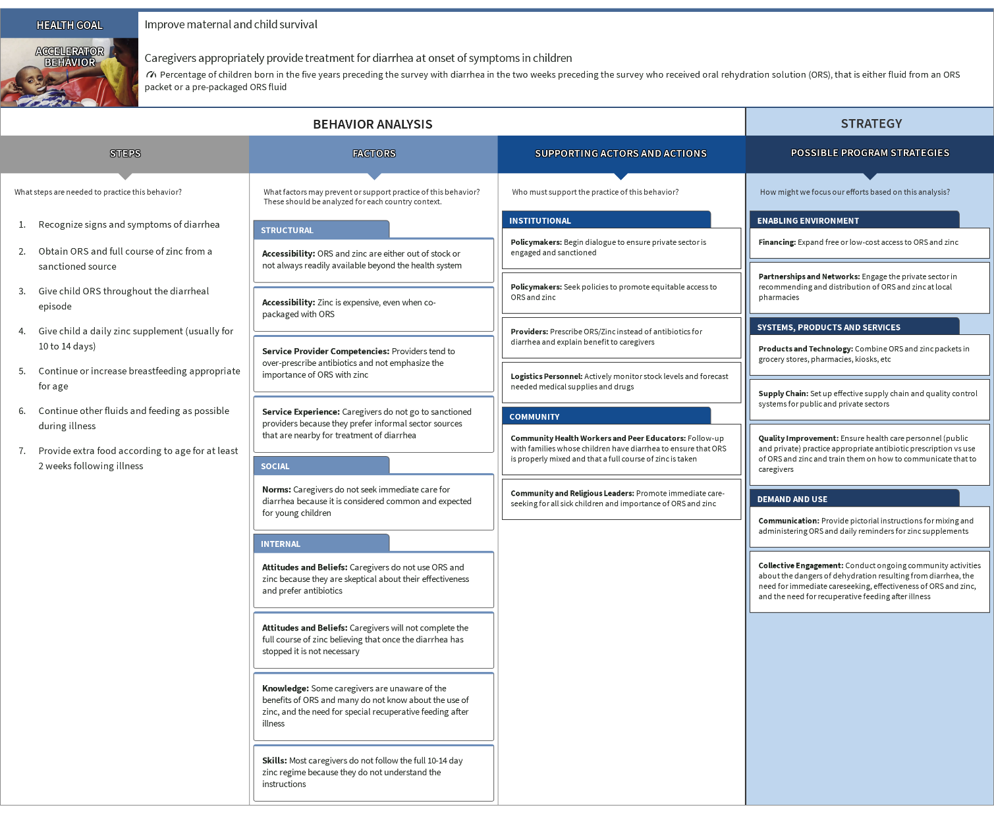
Accelerator Behavior: Treatment for Diarrhea

Slide 4
Accelerator Behavior: Full Course of Immunizations

Slide 5
Accelerator Behavior: Insecticide-Treated Net Use

Slide 6
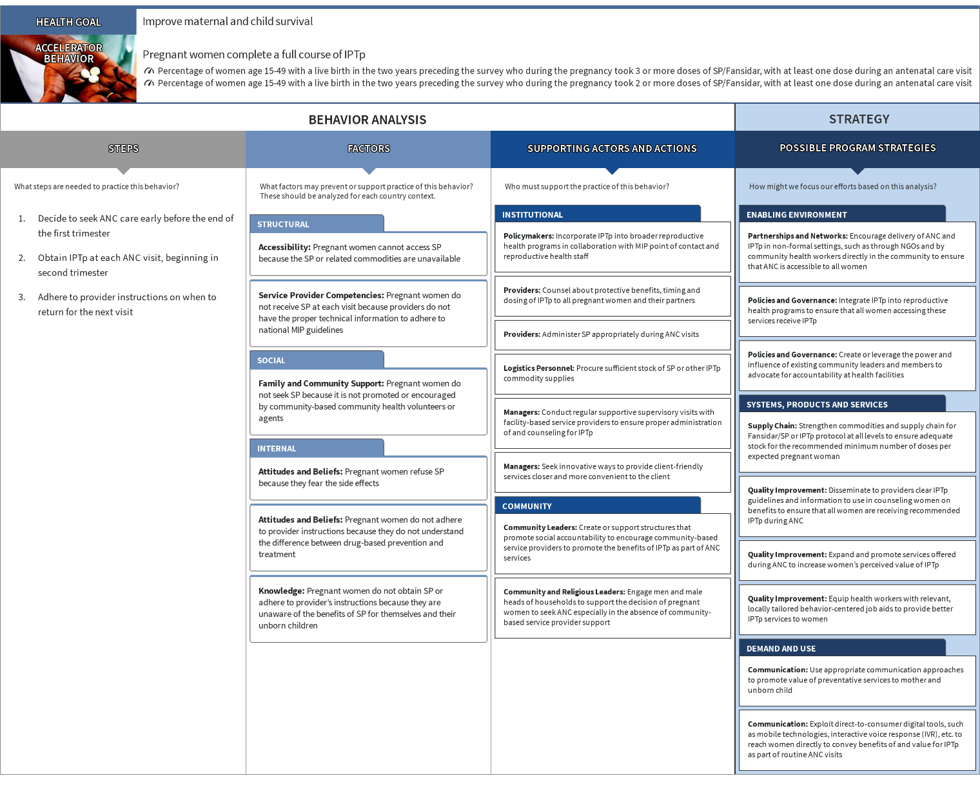
Accelerator Behavior: Intermittent Preventive Treatment of Malaria in Pregnancy

Slide 7
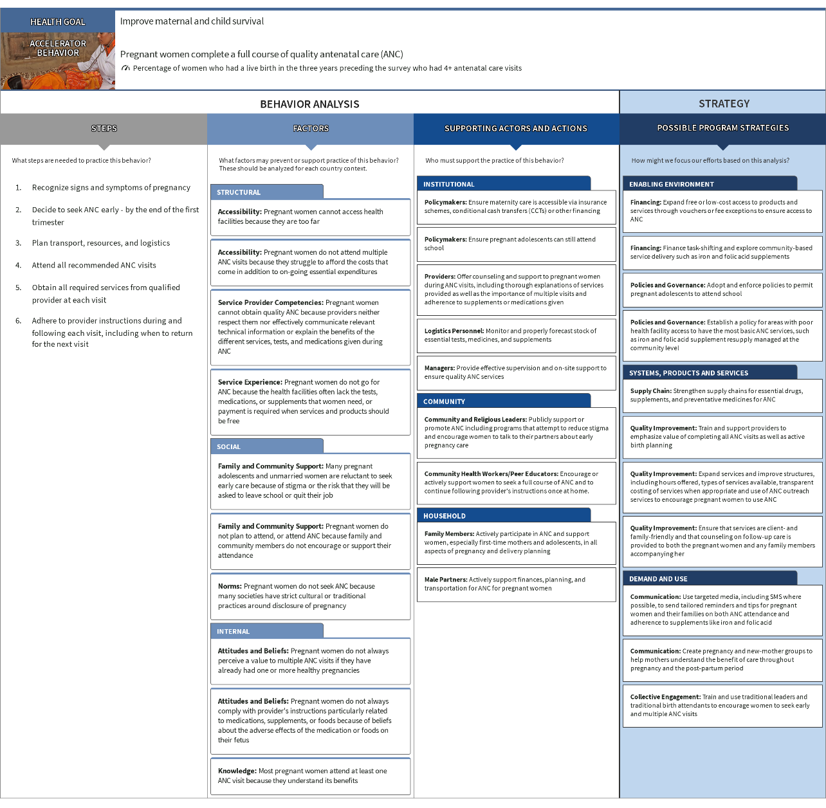
Accelerator Behavior: Antenatal Care

Slide 8
Accelerator Behavior: Delivery in Health Facility

Slide 9
Accelerator Behavior: Essential Newborn Care

Slide 10
Accelerator Behavior: Care for Newborn Illness

Slide 11
Accelerator Behavior: Early Initiation of Breastfeeding

Slide 12
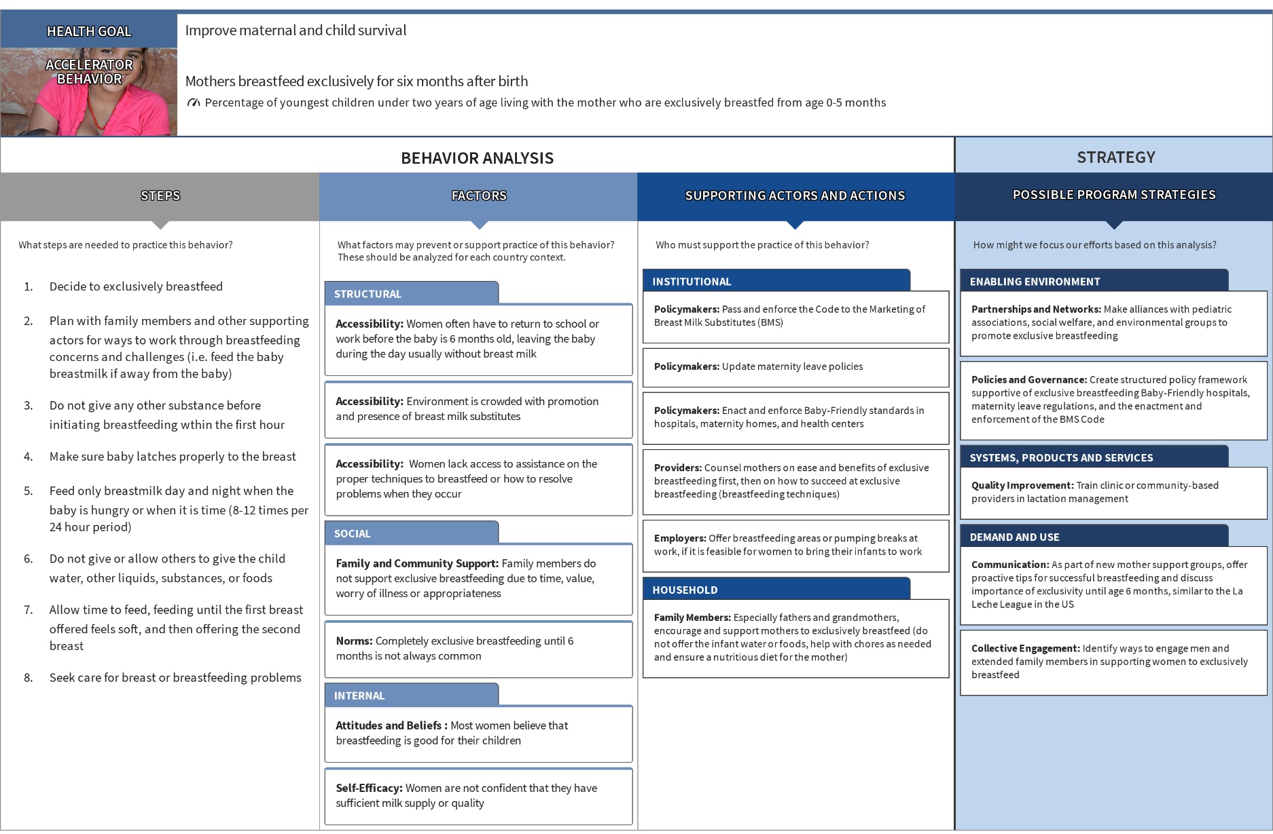
Accelerator Behavior: Exclusive Breastfeeding

Slide 13
Accelerator Behavior: Complementary Feeding

Slide 14
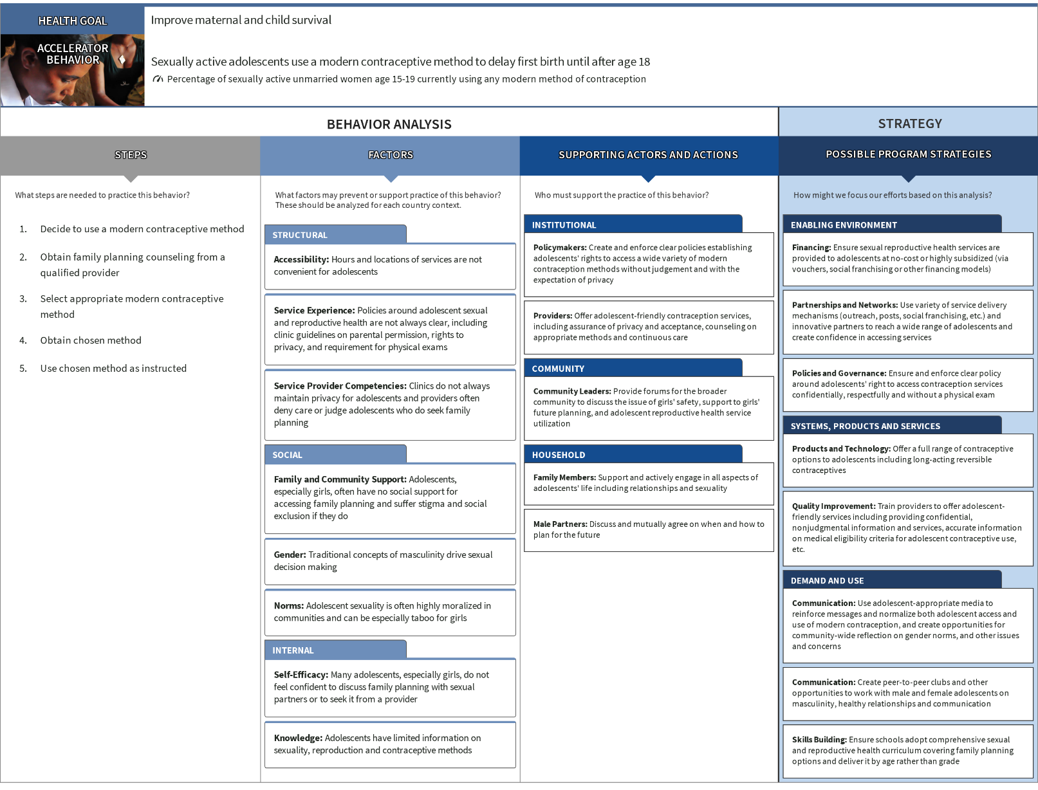
Accelerator Behavior: Adolescent First Birth

Slide 15
Accelerator Behavior: Birth Spacing

Slide 16
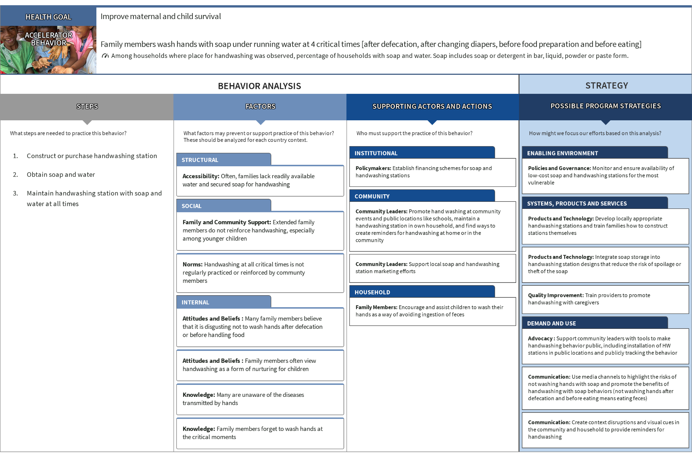
Accelerator Behavior: Handwashing with Soap

Slide 17
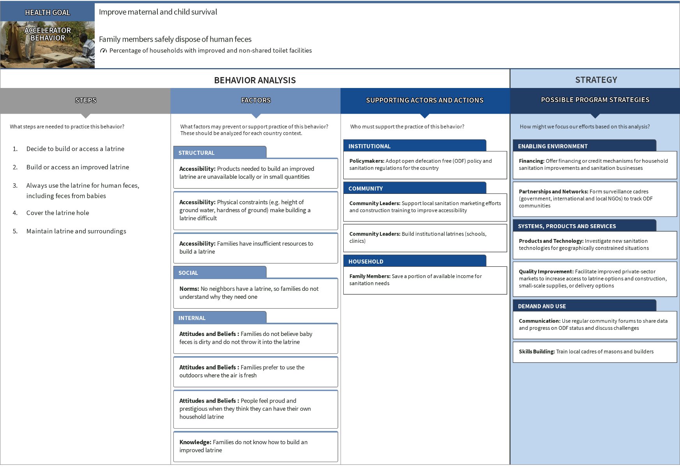
Accelerator Behavior: Safe Disposal of Human Feces

Slide 18
Accelerator Behavior: Safe Drinking Water

